Slide 1
Object detection with yolov3 - colab

Slide 2
Slides Content
About project
Purpose
Dataset
Part 1: Download project materials
Part 2: Download and convert yolov3 pretrained weight
Part 3: Download and preprocess experimental dataset
Part 4: Import libraries and pre-defined functions
Part 5: Link Google drive
Part 6: Define variables and callbacks
Part 7: Finetune yolov3 model using raccoon dataset
Part 8: Test the model.

Slide 3
About project

Slide 4
Purpose
Help student get familiar with object detection using yolov3 model [1] that was pre-trained on a large COCO dataset [2].
Students are able to finetune the yolov3 model to recognize object with a custom dataset (e.g., raccoon dataset [3]) using Google Colab.
[1] Redmon J, Farhadi A. Yolov3: An incremental improvement. arXiv preprint arXiv:1804.02767. 2018 Apr 8.
[2] Lin TY, Maire M, Belongie S, Hays J, Perona P, Ramanan D, Dollár P, Zitnick CL. Microsoft coco: Common objects in context. InEuropean conference on computer vision 2014 Sep 6 (pp. 740-755). Springer, Cham.
[3] https://github.com/datitran/raccoon_dataset

Slide 5
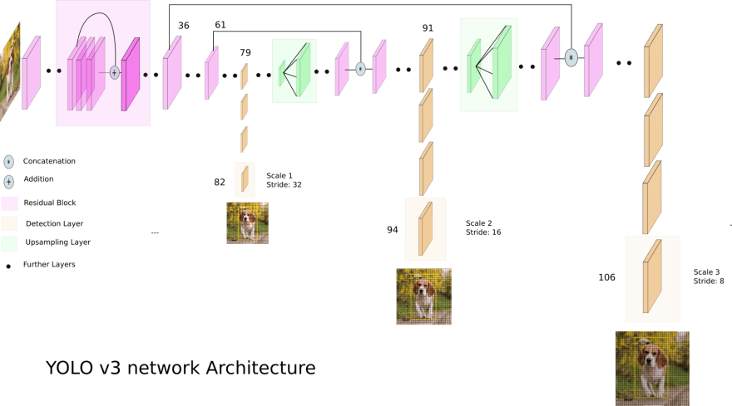
Yolov3 Architecture
Darknet-53
Trained on ImageNet
53 more convolutional layers

Slide 6
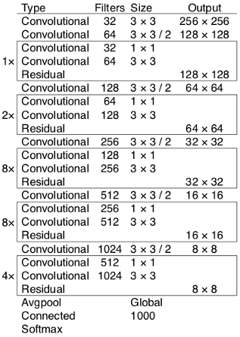
Darknet-53
Darknet-53 is used as a feature extractor.
Darknet-53 mainly composed of 3 x 3 and 1 x 1 filters with skip connections like the residual network in ResNet.

Slide 7
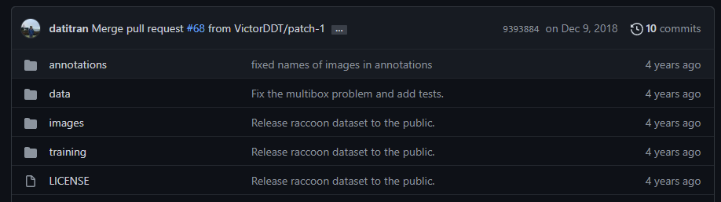
Dataset
In this project, raccoon dataset [1] is used to finetune the yolov3 model.
About raccoon dataset:
Number of classes: 1
Number of images: 200
Annotation file format: Pascal VOC XML (.xml)
[1] https://github.com/datitran/raccoon_dataset

Slide 8
Part 1: Clone project materials

Slide 9
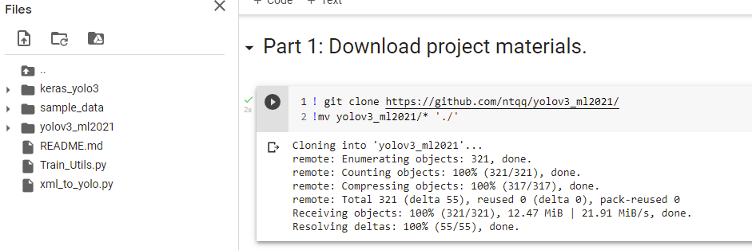
Download project materials

Slide 10
Part 2: Download and convert yolov3 pretrained weight

Slide 11
Download and convert yolov3 pretrained weight
The Yolov3 model in this project is trained using Darknet library, thus the pre-trained weights is in Darknet format (.weights)
We need to covert the pre-trained weight into .h5 file that can be used by TensorFlow Keras.

Slide 12
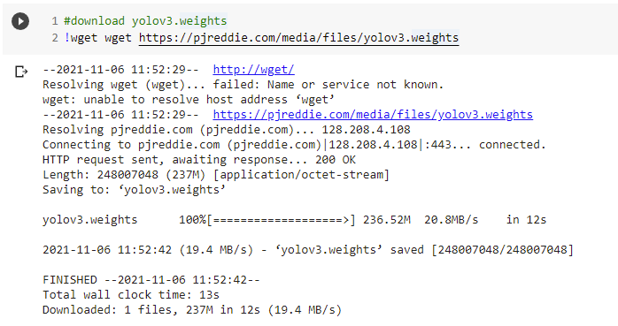
Download and convert yolov3 pretrained weight

Slide 13
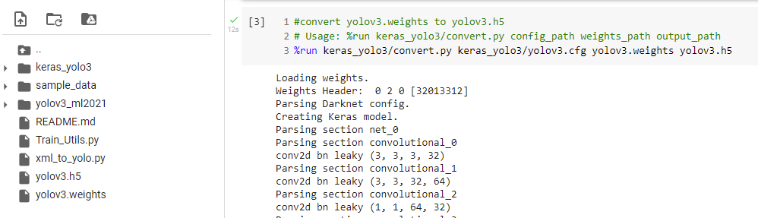
Download and convert yolov3 pretrained weight

Slide 14
Part 3: download and preprocess experimental dataset

Slide 15
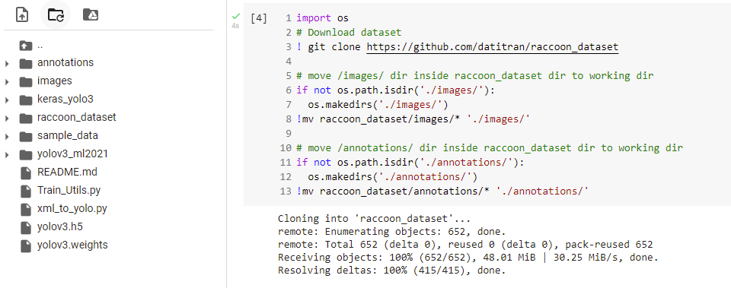
Download experimental dataset

Slide 16
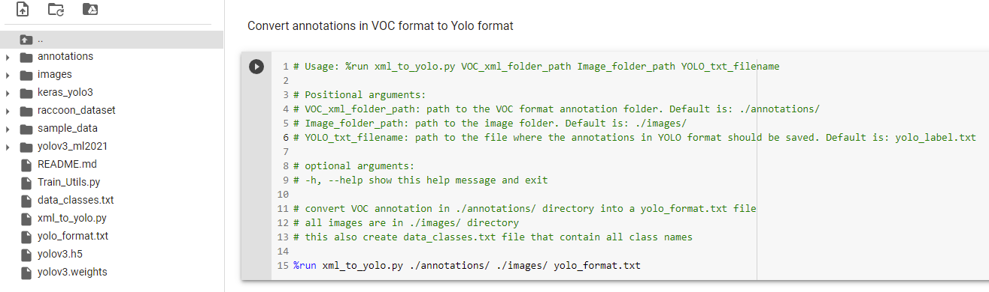
Preprocess dataset

Slide 17
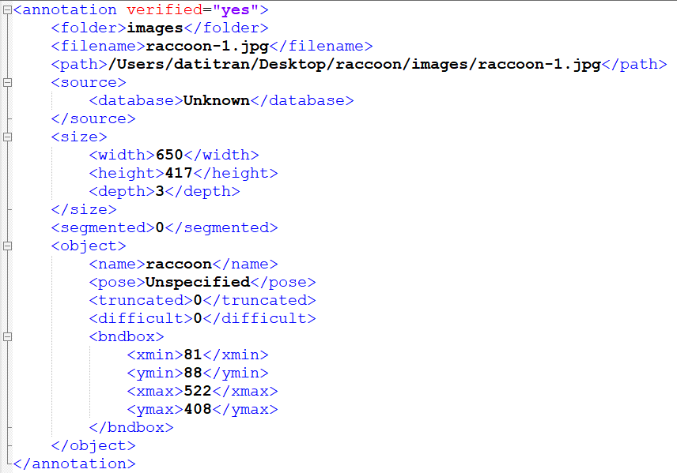
Example of a Pascal VOC XML file
Information we need

Slide 18
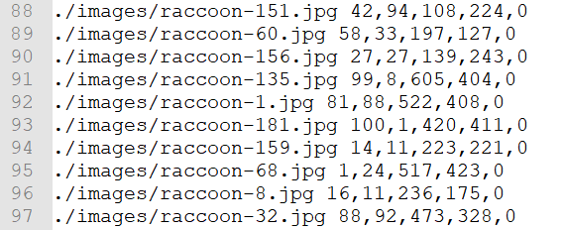
Example of Yolo format file
xmin, ymin, xmax, ymax, class
Images folder path + filename
./images/ + raccoon-1.jpg

Slide 19
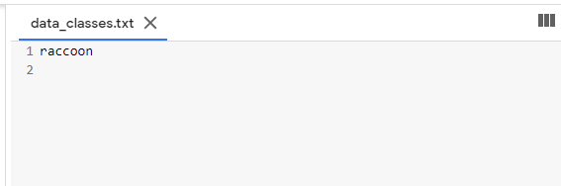
data_classes.txt

Slide 20
Part 4: Import libraries and pre-defined functions

Slide 21
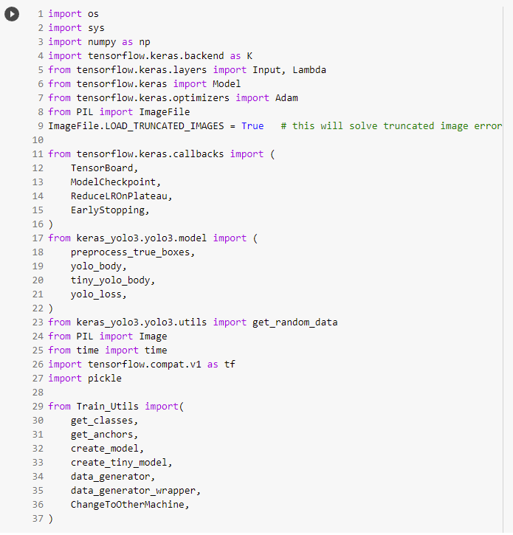
Import libraries and pre-defined functions

Slide 22
Part 5: Mount google drive

Slide 23
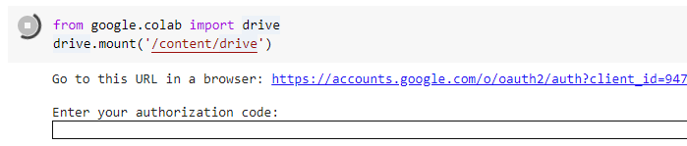
Mount Drive to Colab
Access to the given link

Slide 24
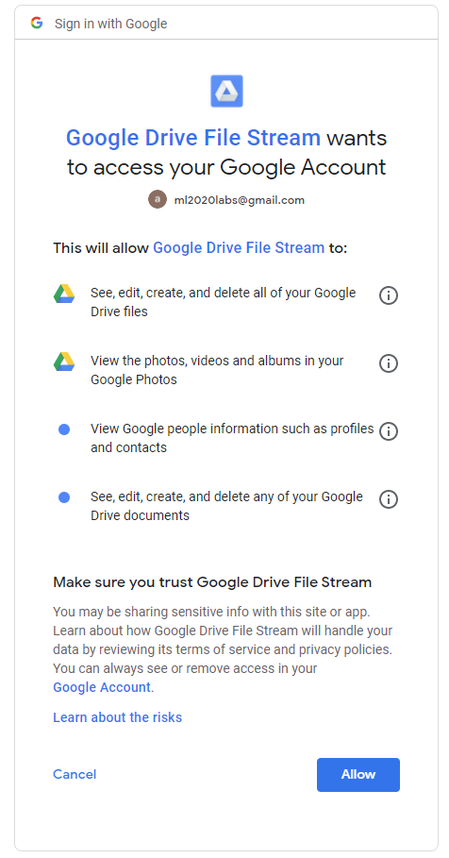
Mount Drive to Colab
Signing and Allow

Slide 25
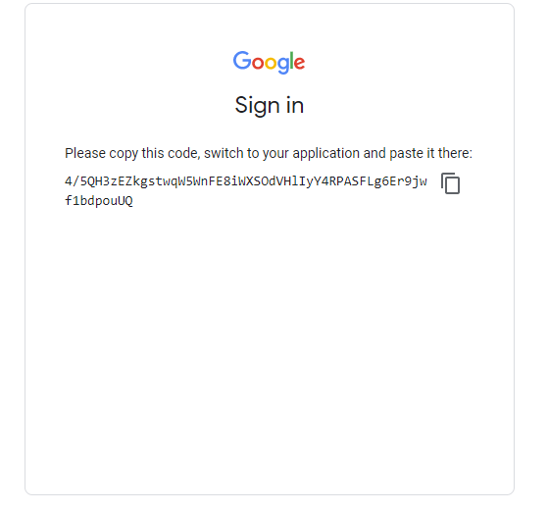
Mount Drive to Colab
Copy the code

Slide 26
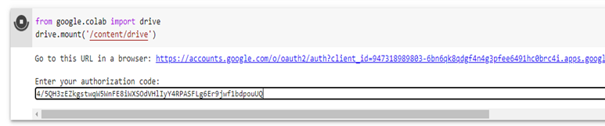
Mount Drive to Colab
Paste the security code here and “Enter”

Slide 27
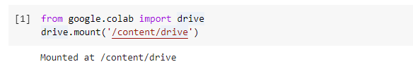
Mount Drive to Colab
Drive mounted

Slide 28
Part 6: Define variables and Callbacks

Slide 29
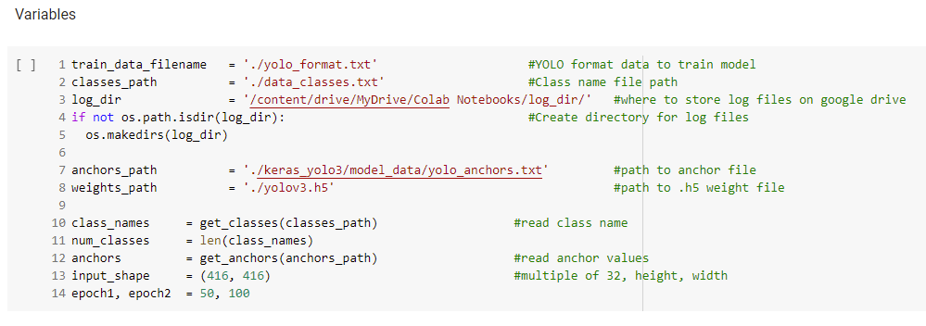
Variables

Slide 30
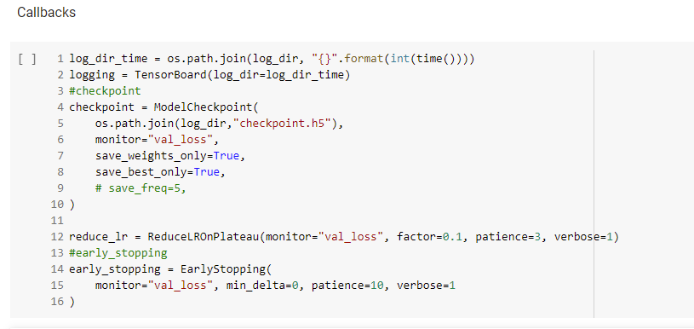
Callbacks

Slide 31
Part 7: Finetune yolov3 model using raccoon dataset

Slide 32
Finetune stage 1
Train with frozen layers first, to get a stable loss

Slide 33
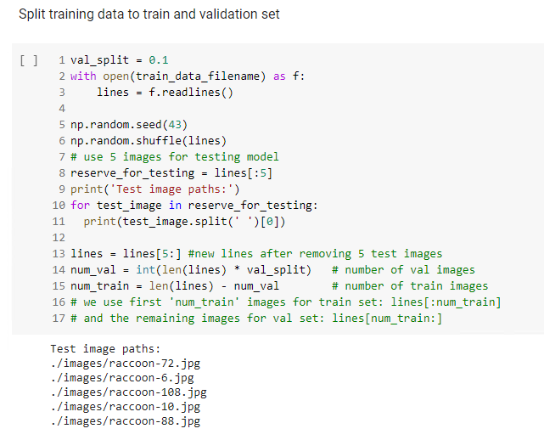
Split data

Slide 34
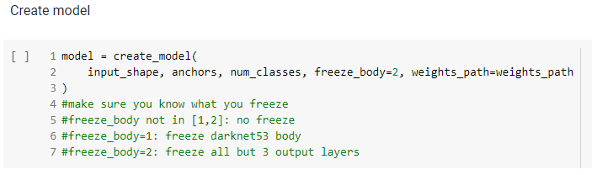
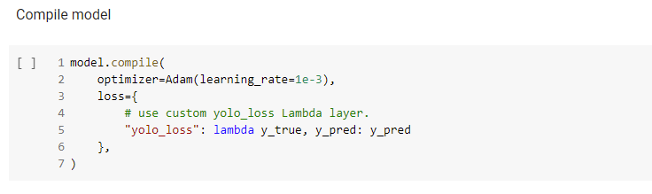
Create and Compile model

Slide 35
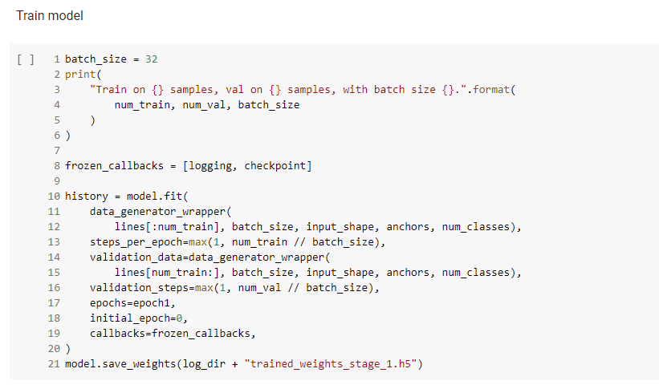
Train model

Slide 36
Finetune stage 2
Unfreeze and continue training, to fine-tune.
Train longer if the result is unsatisfactory.

Slide 37
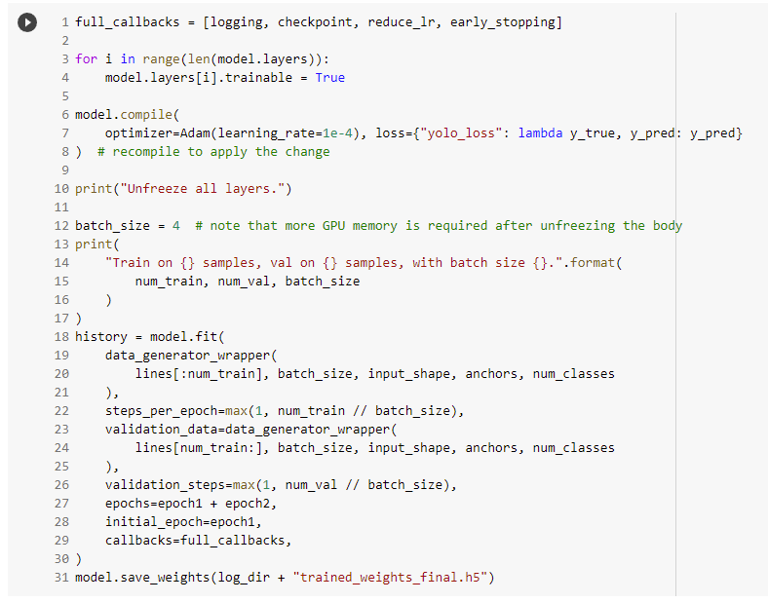
Re-compile and continue to train model

Slide 38
Part 8: Test the model

Slide 39
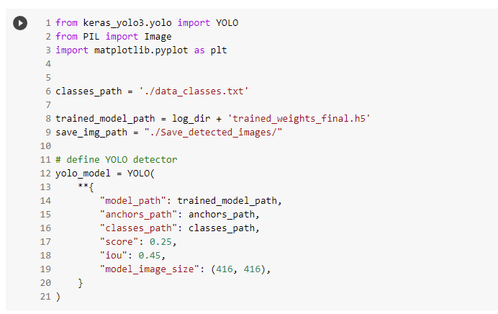
Load the trained model

Slide 40
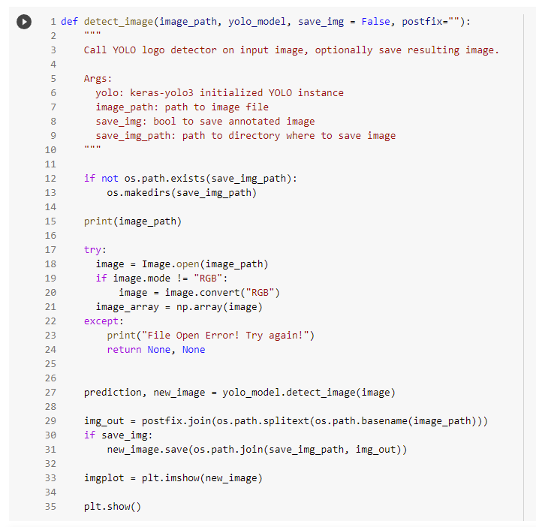
Testing function

Slide 41
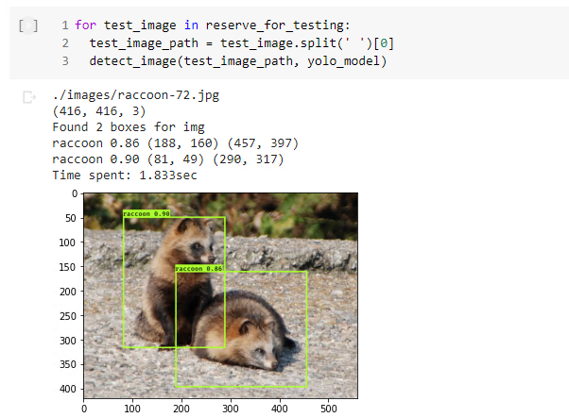
Test the model

Slide 42
Project
Question 1:
Build and train a Kangaroo detection model using Yolov3.
Kangaroo dataset: https://github.com/experiencor/kangaroo
Note: Remember to adjust the folder paths accordingly.
Question 2:
Build an object detection model with your custom dataset. You can create one or multi-class dataset.
Some tips:
To download a batch of images from google images search, you can use this extension on Chrome: https://download-all-images.mobilefirst.me
To annotate images: https://www.makesense.ai/
Upload image and annotation folders to Google drive or Colab workspace to train your model. Remember to adjust the folder paths accordingly.

Slide 43
Project submission
Deadline:
Answer file type: .ipynb
One .ipynb file for each question.
.ipynb file name:
Project_Q1_Student ID_Student Name.ipynb
Project_Q2_Student ID_Student Name.ipynb
Show the test images with bounding boxes.
Submit your answers at:
https://forms.gle/F7xUEisP6ndnvsyFA
If there is any problem when submitting the answer, submit your answer via email at:
Email address: ml2021labs@gmail.com
Email subject: Project_Student ID_Student Name

Slide 44
Create Custom dataset Tutorial

Slide 45
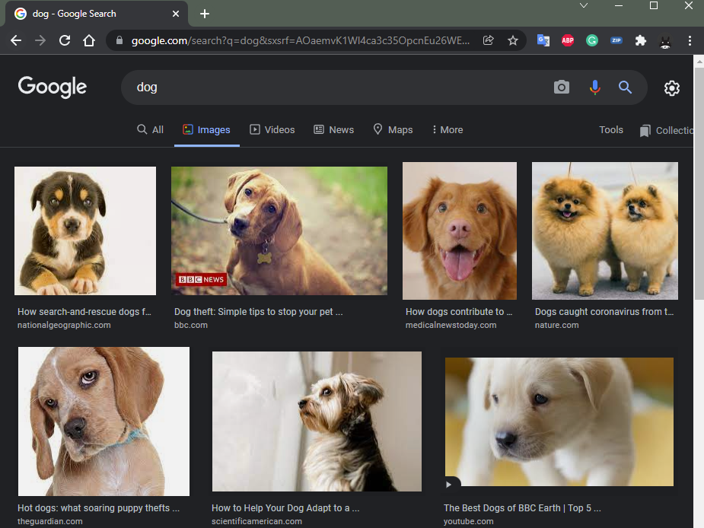
Download a batch of images from google images search
Download all images extension
https://download-all-images.mobilefirst.me

Slide 46
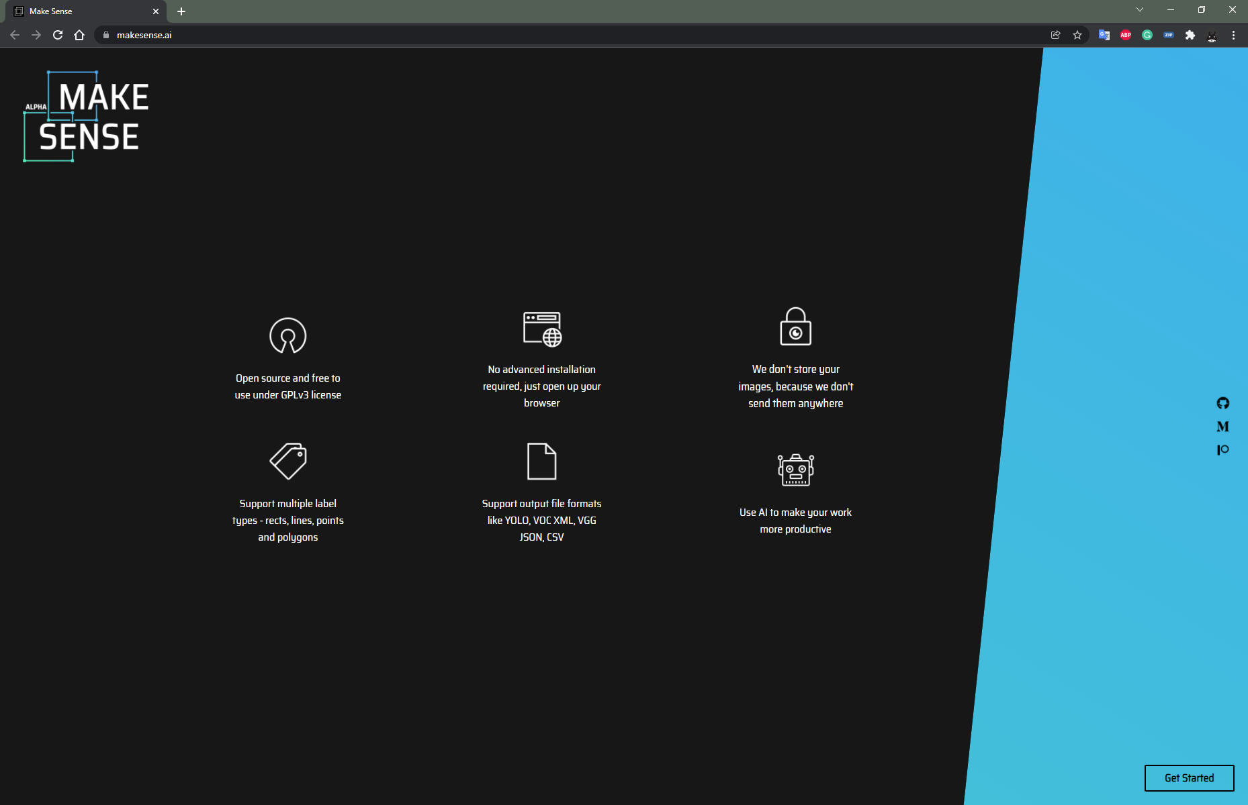
Annotate images
https://www.makesense.ai/

Slide 47
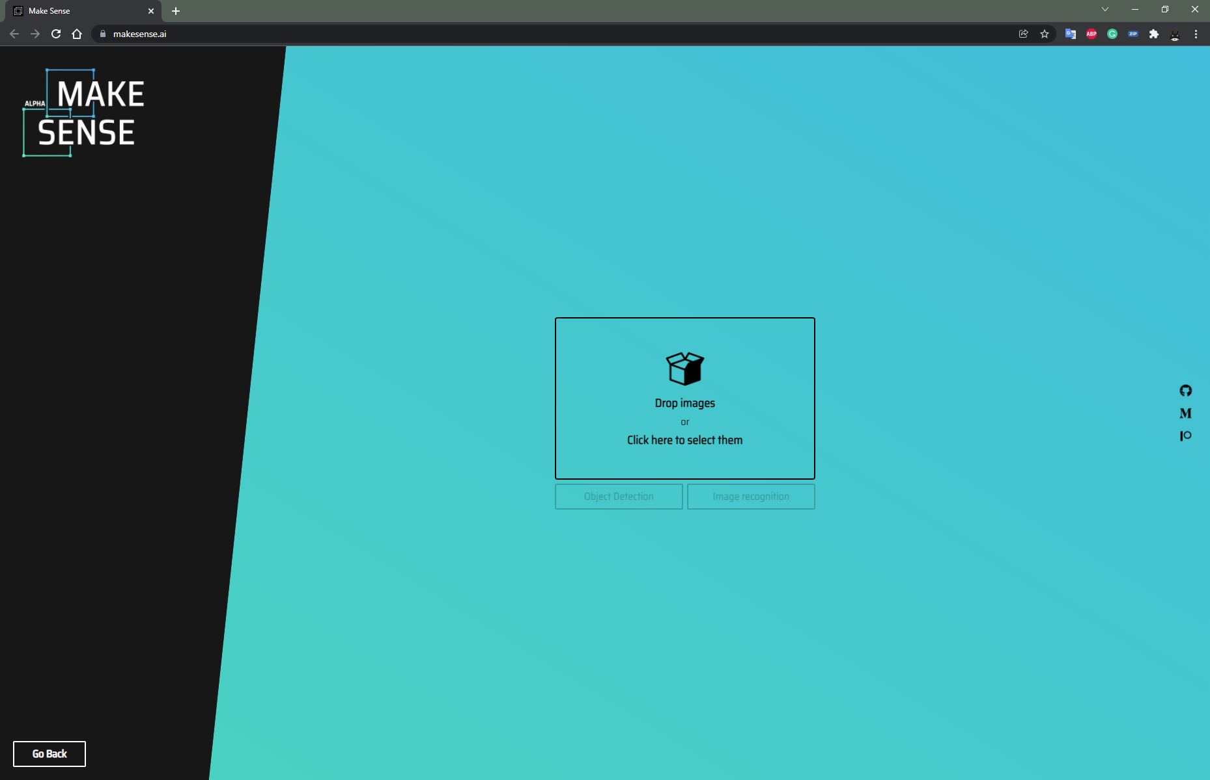
Upload images

Slide 48
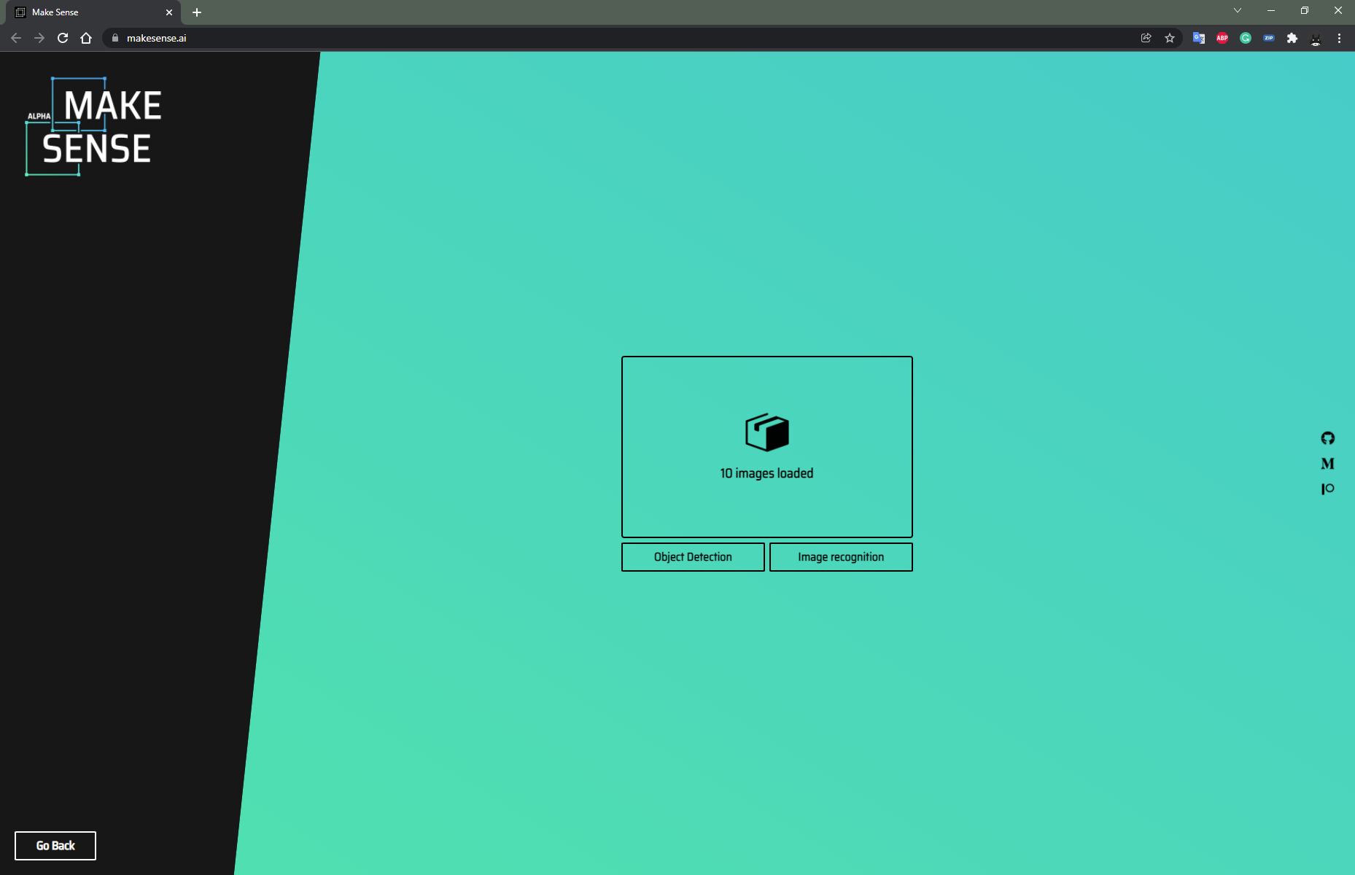
Upload images

Slide 49
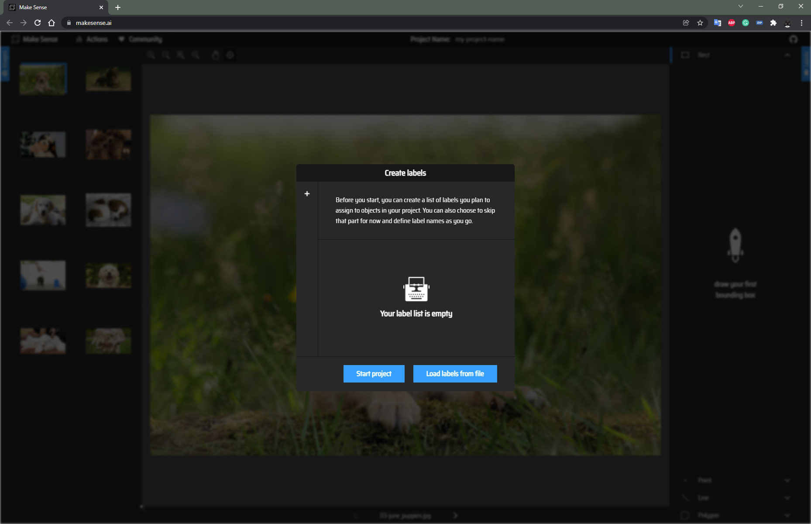
Start project

Slide 50
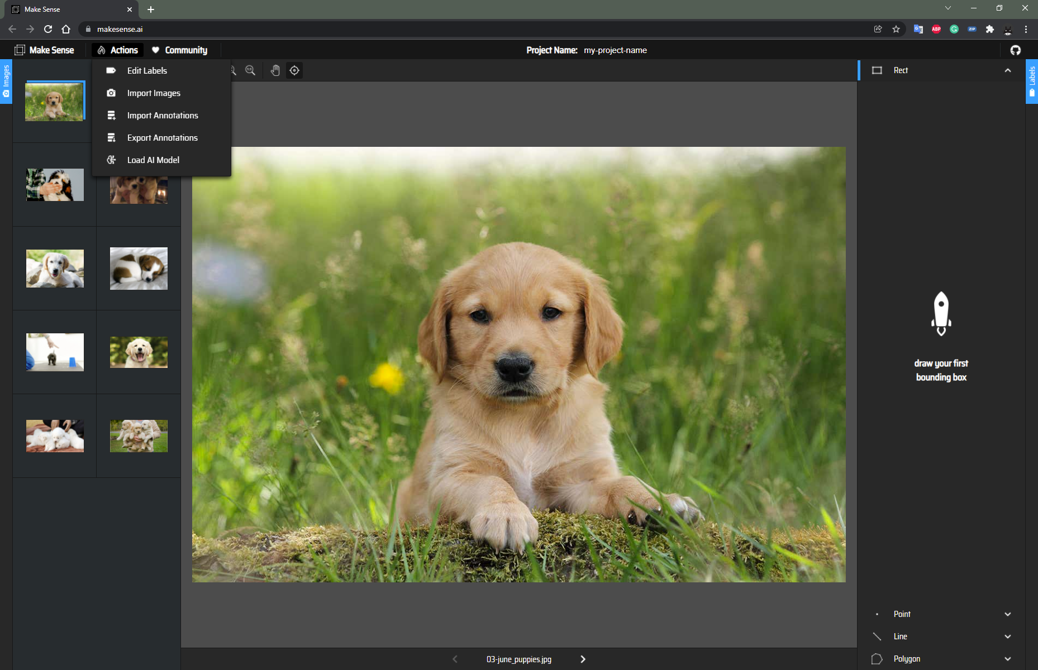
Add label
Actions > Edit Labels

Slide 51
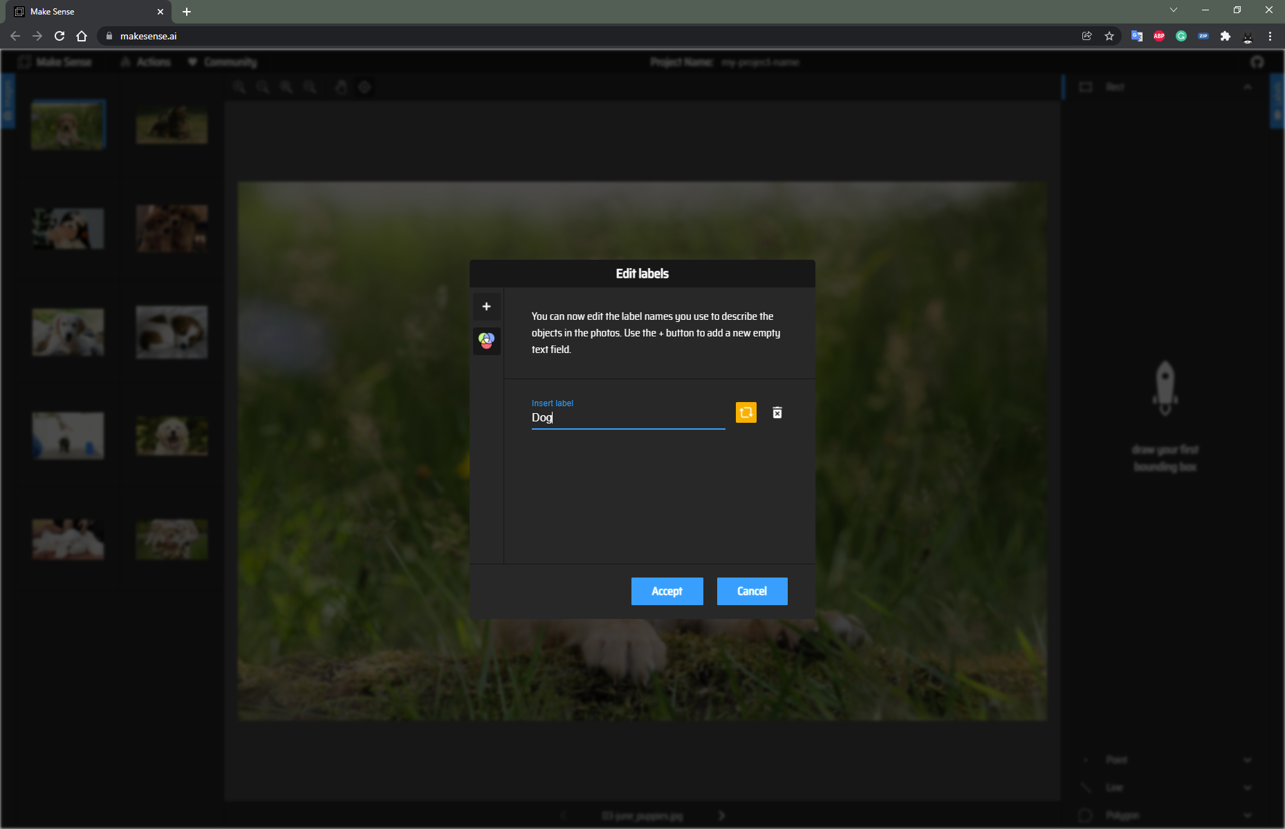
Add label

Slide 52
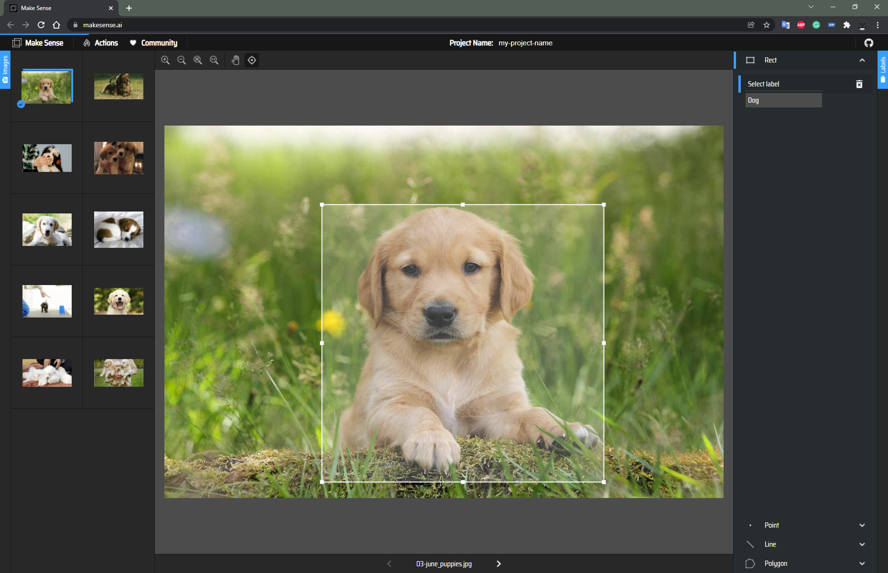
Annotate all images

Slide 53
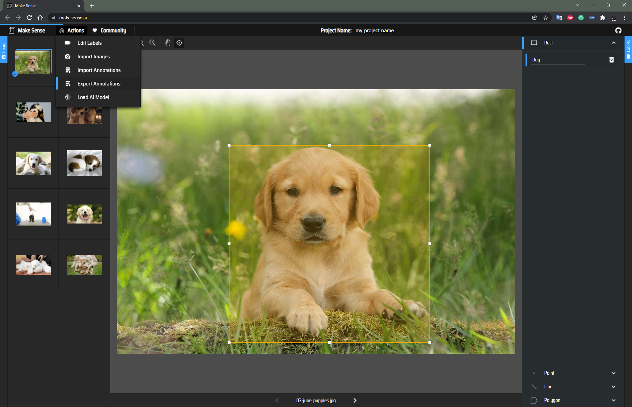
Export Annotations
Actions > Export Annotations

Slide 54
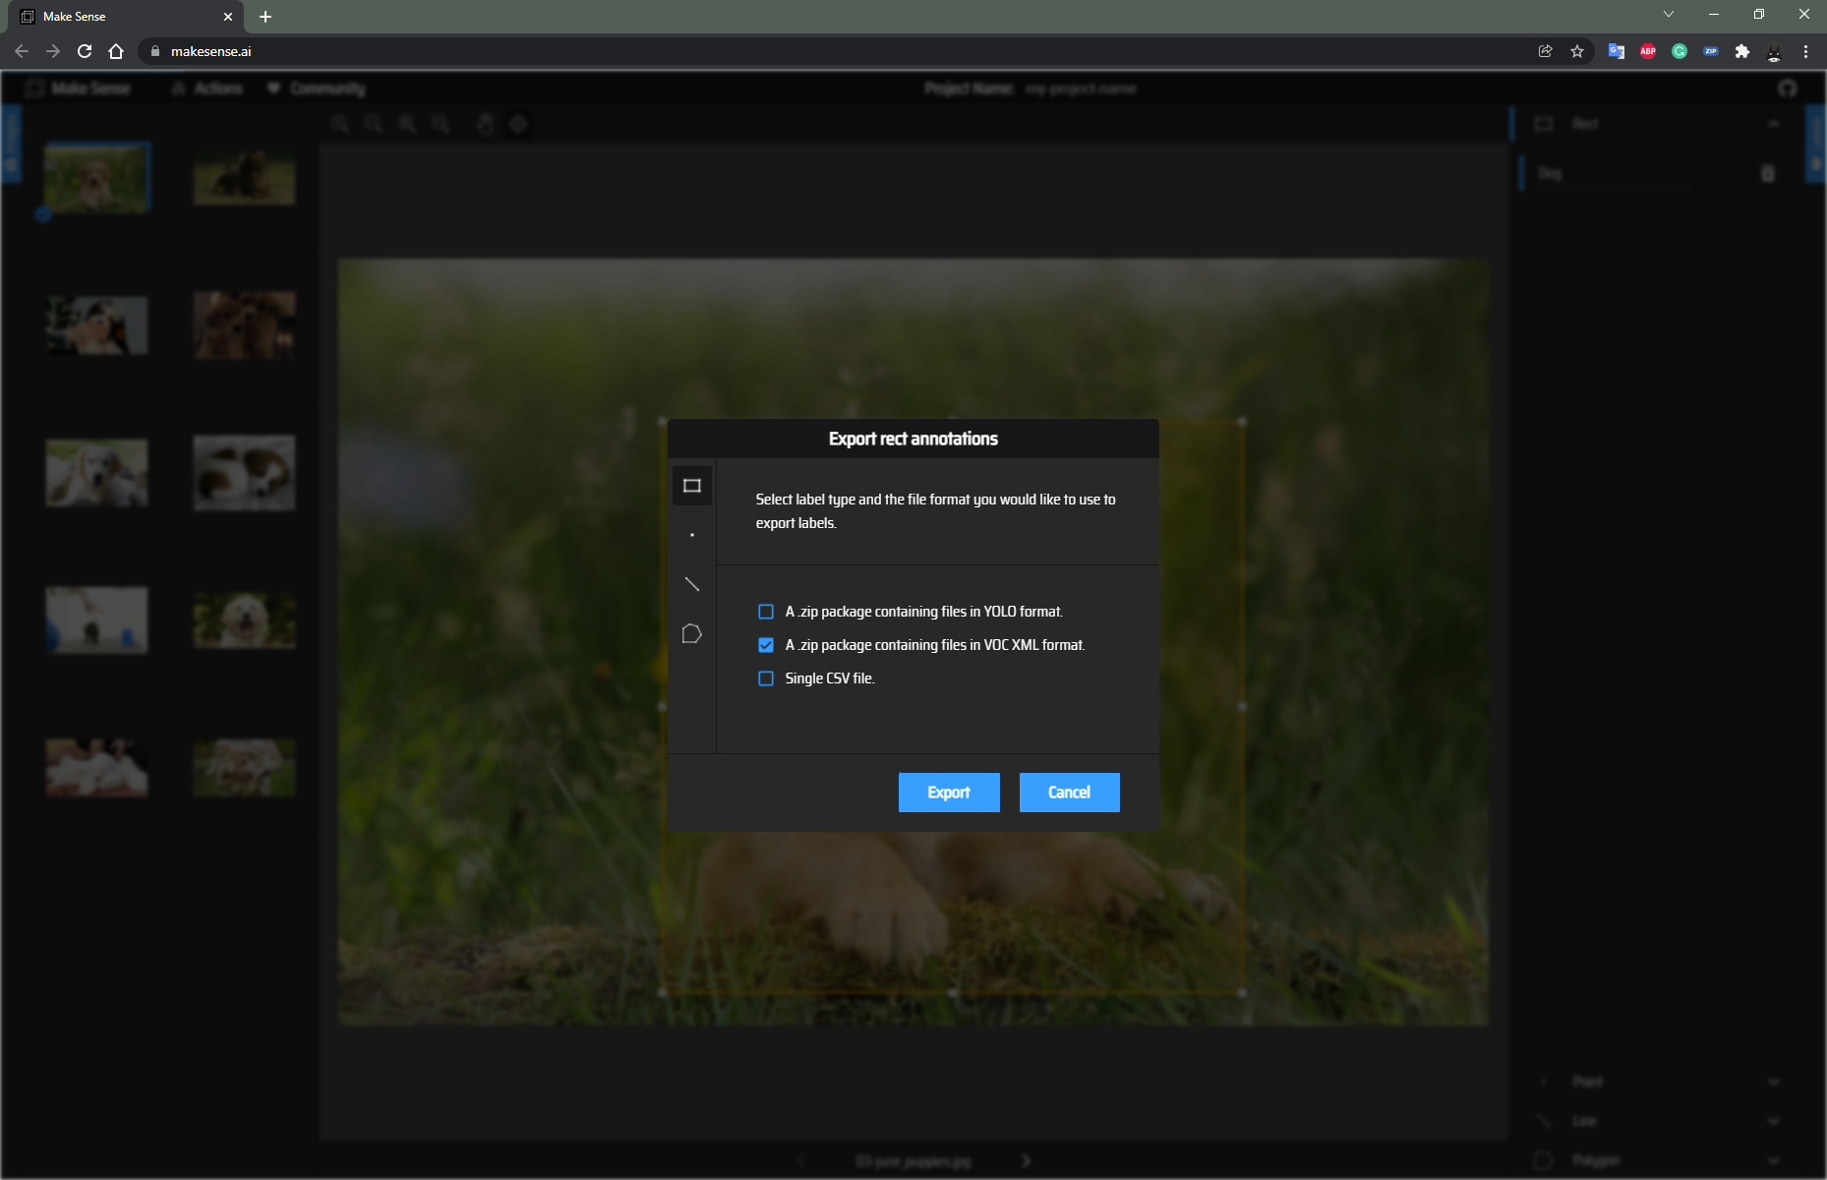
Export Annotations

